Slide 1
R Markdown Tutorial
Gina Griffin, MSW, LCSW June 2019 R-Ladies Tampa!

Slide 2
Getting Started
R Markdown is way to share your code, results, and written commentary.
You can choose lots of different formats such as PDFs, Worde files, Power Point, etc.
There is a lovely R Studio R Markdown cheatsheet here: https://www.rstudio.com/wp-content/uploads/2015/02/rmarkdown-cheatsheet.pdf

Slide 3
Pakcages to Install:
rmarkdown

Slide 4
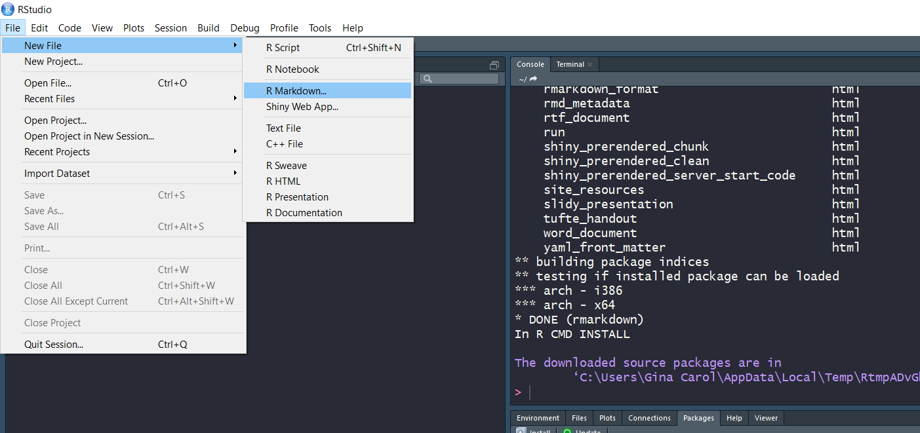
To create an R Markdown Document:

Slide 5
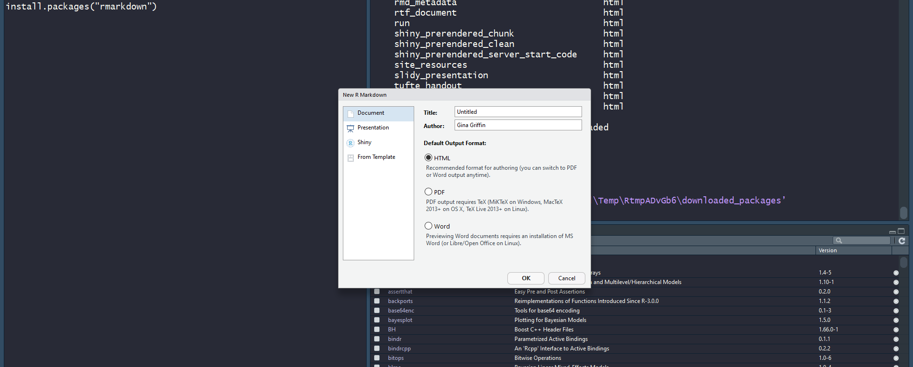
Types of document outputs include HTML (the default), PDF, Word…

Slide 6
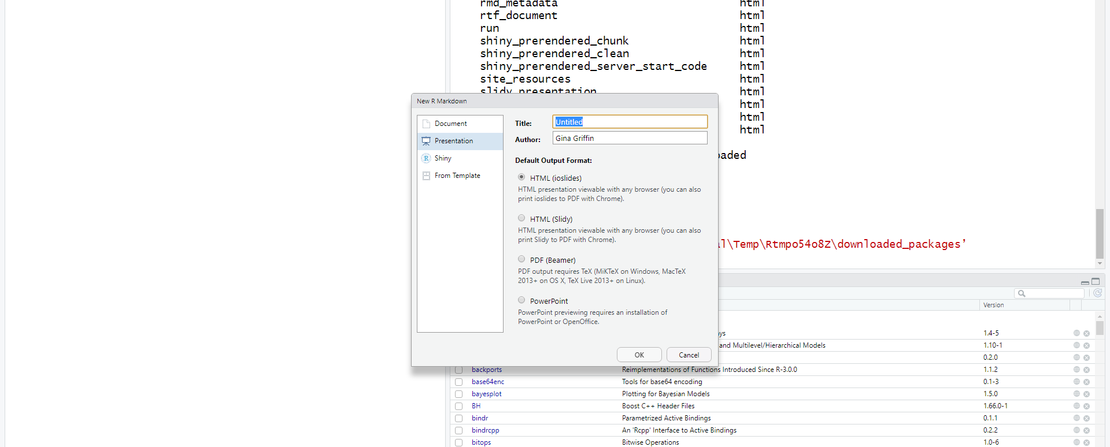
…Also Shiny and Presentation documents. R Studio supports the ability to output PowerPoint files since 2018. (W00t!)

Slide 7
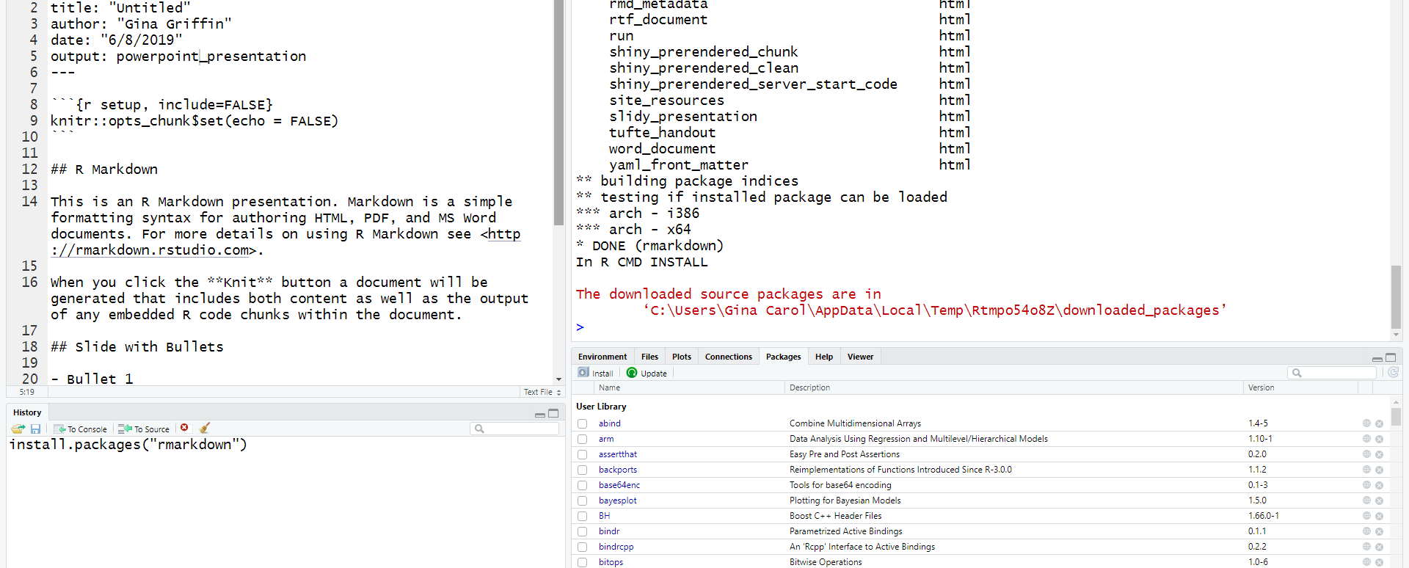
This is what a default file looks like.

Slide 8
The Breakdown
A basic R Markdown file is a .rmd file.
It contains three types of content:
An optional YAML header, surrounded by ---
--- title: “R Markdown Basics” date: 2019-6-8 output: powerpoint_presentation ---
Chunks of code surrounded by ```
Text mixed with simple text formatting like # heading and _italics_.

Slide 9
You can run chunks of code by clicking the Run icon.
To produce a complete report, that includes all of the text, code, and results, click KNIT or use Cmd/Ctrl-Shift-K. This will show the report in the viewer pane. It will also give you a file that you can share with others.
Direct quote from R for DS: “When you knit the document, R Markdown send the .rmd file to knitr to which executes all of the code chunks and creates a new Markdown (.rmd) document, The includes the code and its output. The Markdown file generated by knitr is then processed by pandoc, which is responsible for creating the finished file.”
This allows the creation of a variety of document outputs.

Slide 10
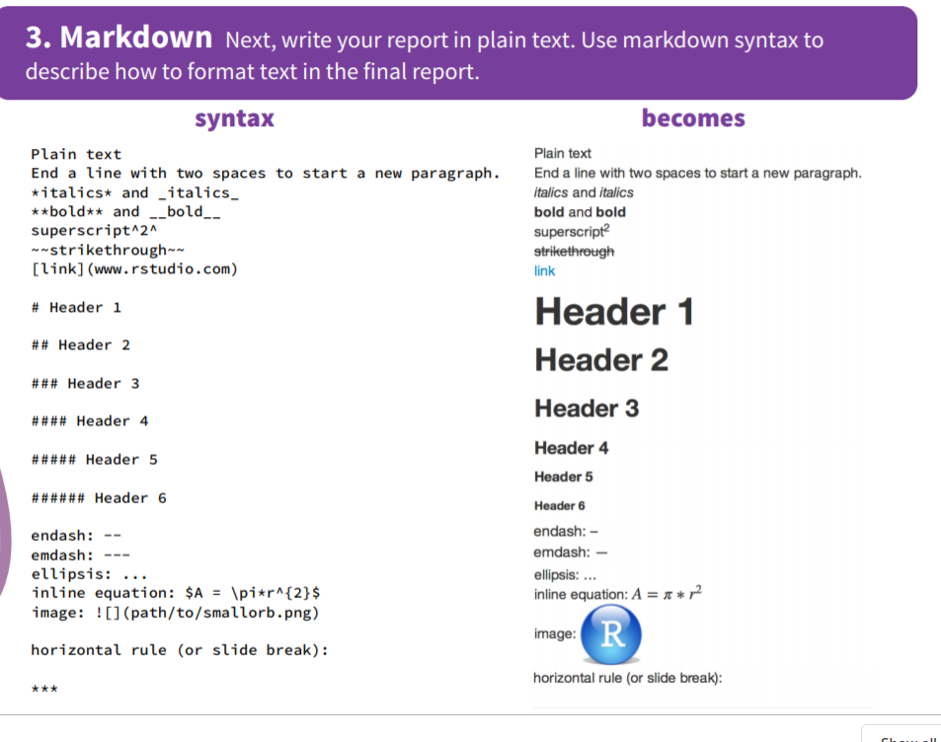
Basic Markdown Formatting:

Slide 11
To add an image:
It must be saved as a .jpg or .png
The best way is to group all images in a folder, to be put in a directory, the directory to which RStudio has access.
Use this format: ![Alt text] (path from directory to image)
So my output of my sassy! Gina picture is : !{Alt text] (\Users\Gina Carol\Desktop\GG-Profile Pic Red.jpg)

Slide 12
Let’s Practice!
Create a new notebook using File > New File > R Notebook. Read the instructions. Practice running the chunks. Verify that you can modify the code, re-run it, and see modified output.
Create a new R Markdown document with File > New File > R Markdown… Knit it by clicking the appropriate button. Knit it by using the appropriate keyboard short cut (Cmd/Ctrl-Shift-K). Verify that you can modify the input and see the output update.
Compare and contrast the R notebook and R markdown files you created above. How are the outputs similar? How are they different? How are the inputs similar? How are they different? What happens if you copy the YAML header from one to the other?
Create one new R Markdown document for each of the three built-in formats: HTML, PDF and Word. Knit each of the three documents. How does the output differ? How does the input differ? (You may need to install LaTeX in order to build the PDF output — RStudio will prompt you if this is necessary.)

Slide 13
Let’s Practice!
Practice what you’ve learned by creating a brief CV. The title should be your name, and you should include headings for (at least) education or employment. Each of the sections should include a bulleted list of jobs/degrees. Highlight the year in bold.
Using the R Markdown quick reference, figure out how to:
Add a footnote.
Add a horizontal rule.
Add a block quote.

Slide 14
References:
https://rmarkdown.rstudio.com/articles_intro.html
https://bookdown.org/yihui/rmarkdown/powerpoint-presentation.hthttps://rpubs.com/RatherBit/90926ml
https://r4ds.had.co.nz/

